Slide 1
Model Assessment and Selection
Week 4

Slide 2
Recall
Saw machine learning process
Have looked at different models
How do we know our model works on data we have not seen?
Similarly what is the best model?

Slide 3
Bias and Variance
Are you familiar with the concept of bias?
What do you think variance is?
Image courtesy of Microsoft

Slide 4

Mathematically
Suppose true relation is $y=f(x)$
We find function $y_{ap}=f_{ap}(x)$
$$Bias=f\left(x\right)−E[f_{ap}(x)]$$
$$Variance=E[{\left(f_{ap}\left(x\right) −E\left[f_{ap}\left(x\right)\right]\right)}^{2}]$$
$$Total Error=σ_{e}^{2}+Bias^{2}+Variance$$

Slide 5
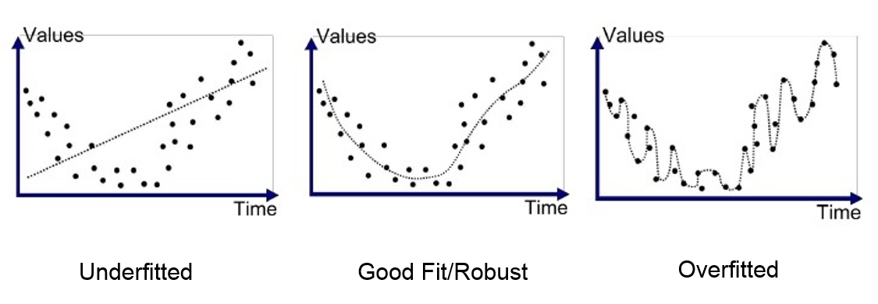
Overfitting and Underfitting
High Bias
High Variance

Slide 6
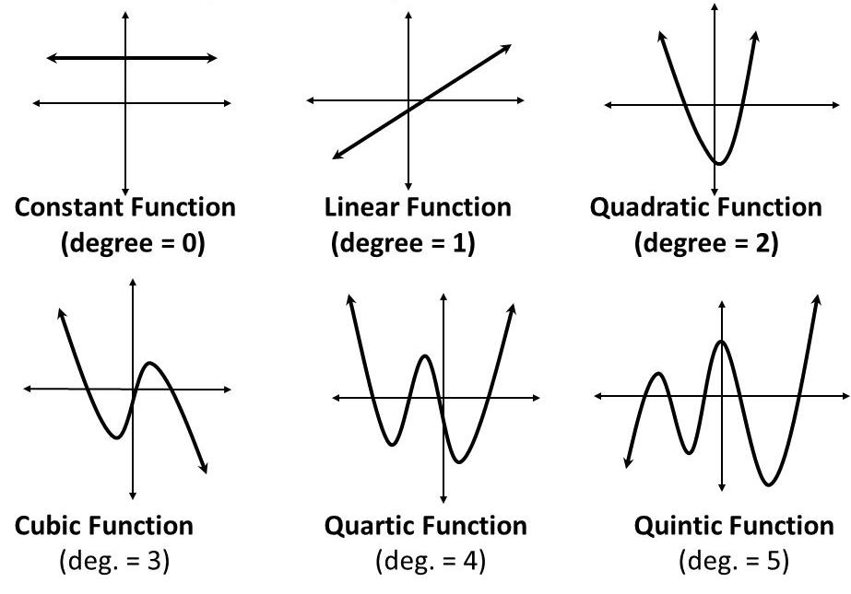
Model Complexity

Slide 7
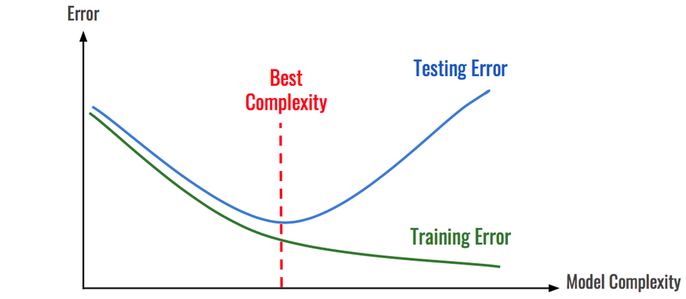
Model Assessment: Does our model generalize well?
Training error lowest for overfit
Does not generalize well
Split data into two sets
Training
Testing
Randomly shuffle data beforehand (not always)

Slide 8
Model Selection: Which model should we select?
Model selection gives us another headache
Introduce another variable: complexity
Training data trains model parameters
Selecting complexity on testing data is training the complexity variable using the testing data
Testing error will not give us reasonable estimate of general error

Slide 9
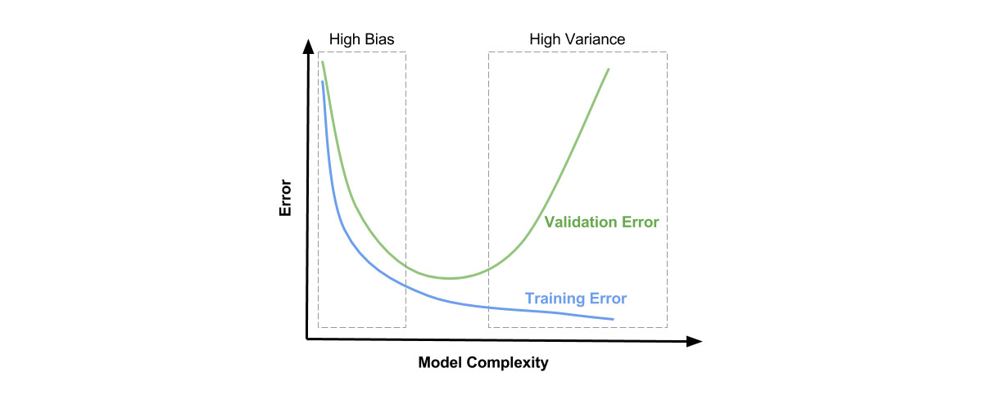
Validation: Bias-Variance Tradeoff
Split into three data sets:
Training
Validation
Testing
Compare complexity on validation set!!
No general rule on split
I usually do 60%, 20%, 20%

Slide 10
K-fold Cross Validation
Validation useful in rich data scenarios
Can suffer from the problem of variance
Alternative is K-fold Cross Validation
Let us see how it works

Slide 11

5-fold Cross Validation

Slide 12
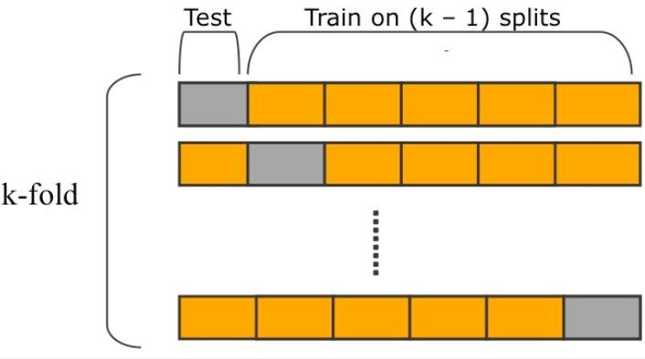
K-fold Cross Validation: Another Practice

Slide 13
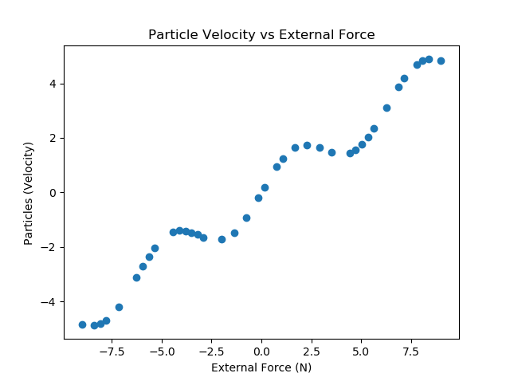
Charged Particle Velocity Problem
Charged particles traveling in vacuum
External force applied
Changes their velocity
60 samples

Slide 14
Errors
Trained multiple models on 60, 20, 20 split
Training MSE = [0.31675926011276007, 0.31665539355938827, 0.2705668507901347, 0.2639507069868053, 0.2580151434100809]
Validation MSE = [0.2663782814225056, 0.2750396129150836, 0.35398780947196556, 0.3755240538849297, 0.6339501714191352]
Test MSE = 0.523

Slide 15
Caution
Number of samples too small (60)
Different random shuffle may provide different error split
Training MSE = [0.30201344279905334, 0.3020132994315647,
0.28685588407522167, 0.2834621263105373, 0.24754556315297632]
Validation MSE = [0.30321342237809407, 0.3031296005933797, 0.24578178333941017, 0.2654345214931992, 0.5087652218542141]

Slide 16
5-fold Cross Validation
Split data into 5 folds
Average Validation MSE = [ 0.42879803, 1.28308413, 1.50856795, 18.27584073, 60.92149784]
More confidence that linear is the best model

Slide 17
Recap
You now have all you need to solve your assessment 1 problem
You should ask yourself what have you learned?
If you can’t answer that question, then we have to work harder

